Slide 1
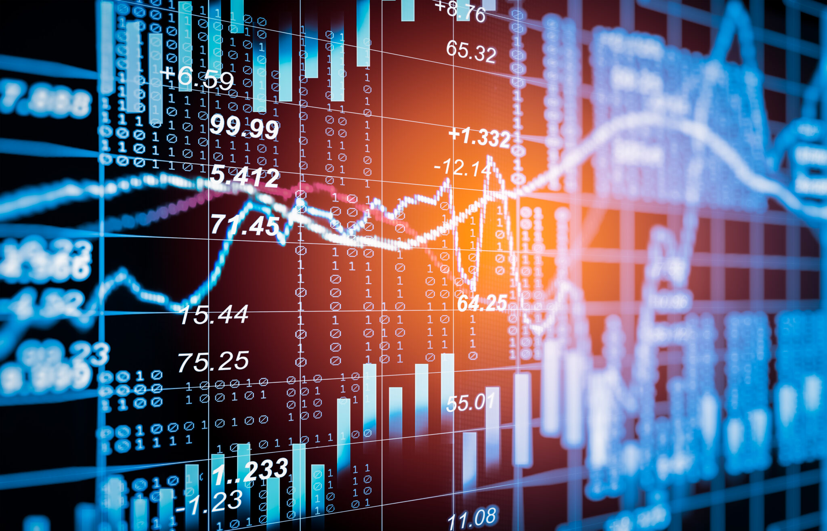

NIFTY 50 Multi-Asset Algorithmic Trading System
Subtitle :-Integrating HMM Regimes & ML Filters with Options Greeks
Main objective :- To build a high-performance trading pipeline using Spot, Futures, and Options data.
prepared by:- Ujjwal aggrawal

Slide 2
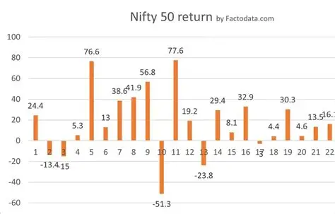
Data Architecture
NIFTY 50 Spot: 5-minute OHLCV (1 Year).
NIFTY Futures: Continuous contract with monthly rollover logic.
NIFTY Options: ATM $\pm$ 2 strikes (Call & Put). Engineering Process:
Cleaning: Outlier removal (Z-score > 3) and timestamp alignment.
Integration: Merging disparate datasets into a unified 5-minute timeframe.

Slide 3
Feature Engineering & Greeks
Calculated using Black-Scholes Model (Risk-free rate: 6.5%).
Metrics: Delta, Gamma, Theta, Vega, and Rho. Derived Alpha Features:
PCR (Put-Call Ratio): Measures market sentiment.
Futures Basis: Difference between Futures and Spot price.
Gamma Exposure: Identifying potential "Squeeze" zones.

Slide 4
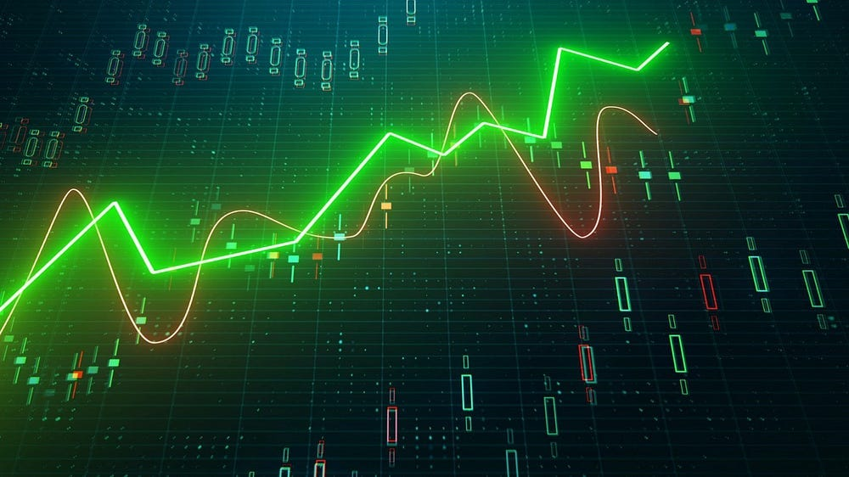
Market Regime Detection
State +1 (Uptrend): Positive drift, moderate volatility.
State -1 (Downtrend): Negative drift, high volatility.
State 0 (Sideways): Neutral drift, low volatility. Inputs: Average IV, IV Spread, PCR, and Futures Basis.

Slide 5
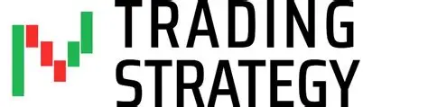
Long: EMA(5) > EMA(15) AND HMM Regime = +1.
Short: EMA(5) < EMA(15) AND HMM Regime = -1.
Filter: No trades executed in Regime 0 to avoid "Chop" or "Whipsaws."
Execution: Enter/Exit at the next candle open.

Slide 6

Machine Learning Enhancement
Model: XGBoost Binary Classifier.
Target: Predict if a generated signal will result in a profit > 0.
Logic: Even if a trend is detected, the ML model may veto the trade if Options positioning (Gamma/IV) suggests a fake-out.
Confidence Threshold: $P(Profit) > 0.5$.

Slide 7
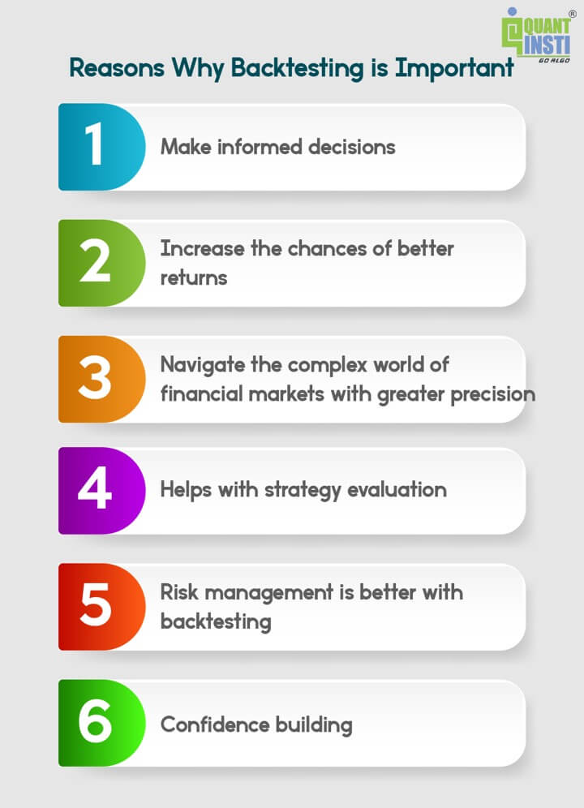
Backtesting Results
Training Set: First 70% | Testing Set: Last 30%.
Baseline: Standard EMA Crossover.
Enhanced: EMA + HMM + XGBoost. Key Performance Indicators (KPIs):
Sharpe Ratio Improvement.
Reduction in Max Drawdown.
Higher Win Rate via ML filtering.

Slide 8
High-Performance Outlier Analysis
Trades with Z-score > 3 in PnL.
Key Finding: Outliers typically occur during high Gamma Exposure and narrowing IV Spreads.
Time of Day: Concentration of high-alpha trades during the first and last hours of the market.

Slide 9
Statistical Comparison
Metric | Baseline | ML-Enhanced
Win Rate | 42% | 58%
Sharpe Ratio | 0.85 | 1.62
Max Drawdown | -18% | -7%
Profit Factor | 1.2 | 2.1

Slide 10
Conclusion
Multi-asset data provides a 3D view of the market.
Regime detection is the most effective way to reduce "noise."
ML filters can significantly improve the quality of trend-following entries. Next Steps:
Live Paper Trading via Zerodha/ICICI API.
Adding "Order Flow" features (Volume Clusters).

Slide 11


